Slide 1

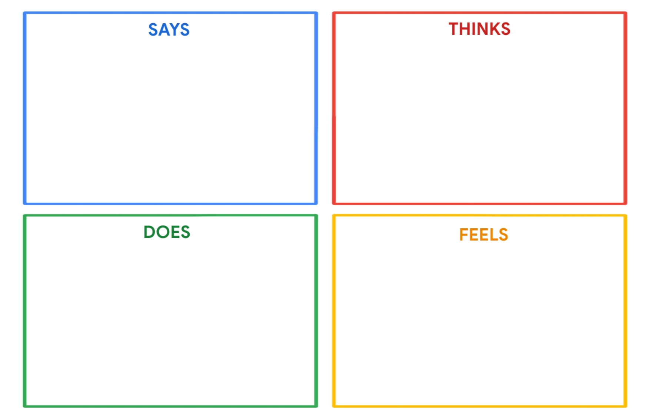
Seif Mohamed
"I want to become a software engineer and create technology."
"I enjoy playing sports as a way to stay active and have fun."
"Limited tech resources can be frustrating."
"Balancing my interests in programming, sports, and reading can be challenging."
"How can I pursue my dream of becoming a software developer?"
"Sports provide me with an outlet for physical activity and relaxation."
"Reading and writing help me express my thoughts and imagination."
"I need a quiet and focused environment to work on my programming."
Seif actively engages in programming and coding activities to develop his skills.
He participates in sports and physical activities to stay active and unwind.
He spends time reading and writing as a way to express his creativity.
He may express frustration when dealing with limited tech resources.
Seif is determined to become a software engineer and make a positive impact
Sports bring him joy, relaxation, and physical well-being.
Reading and writing provide a creative and intellectual outlet.
He feels annoyed by unnecessary chatter

